Slide 1
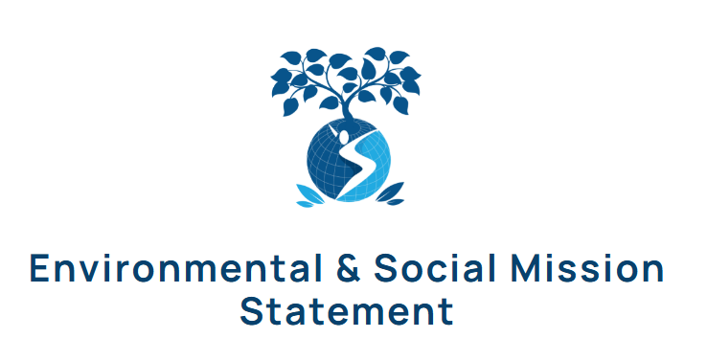
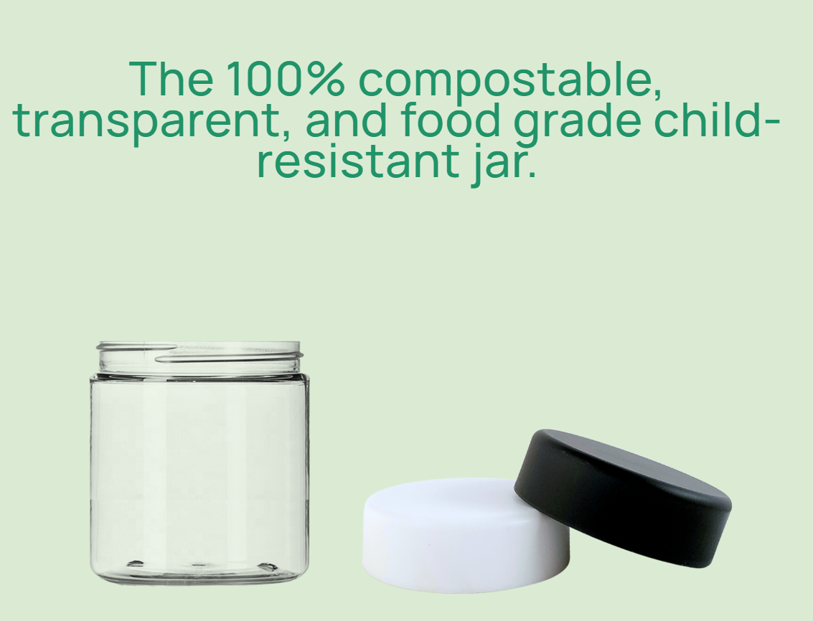
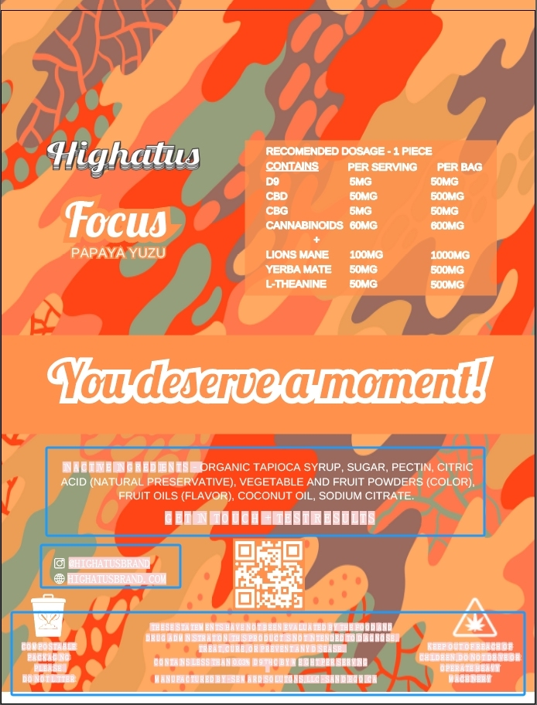
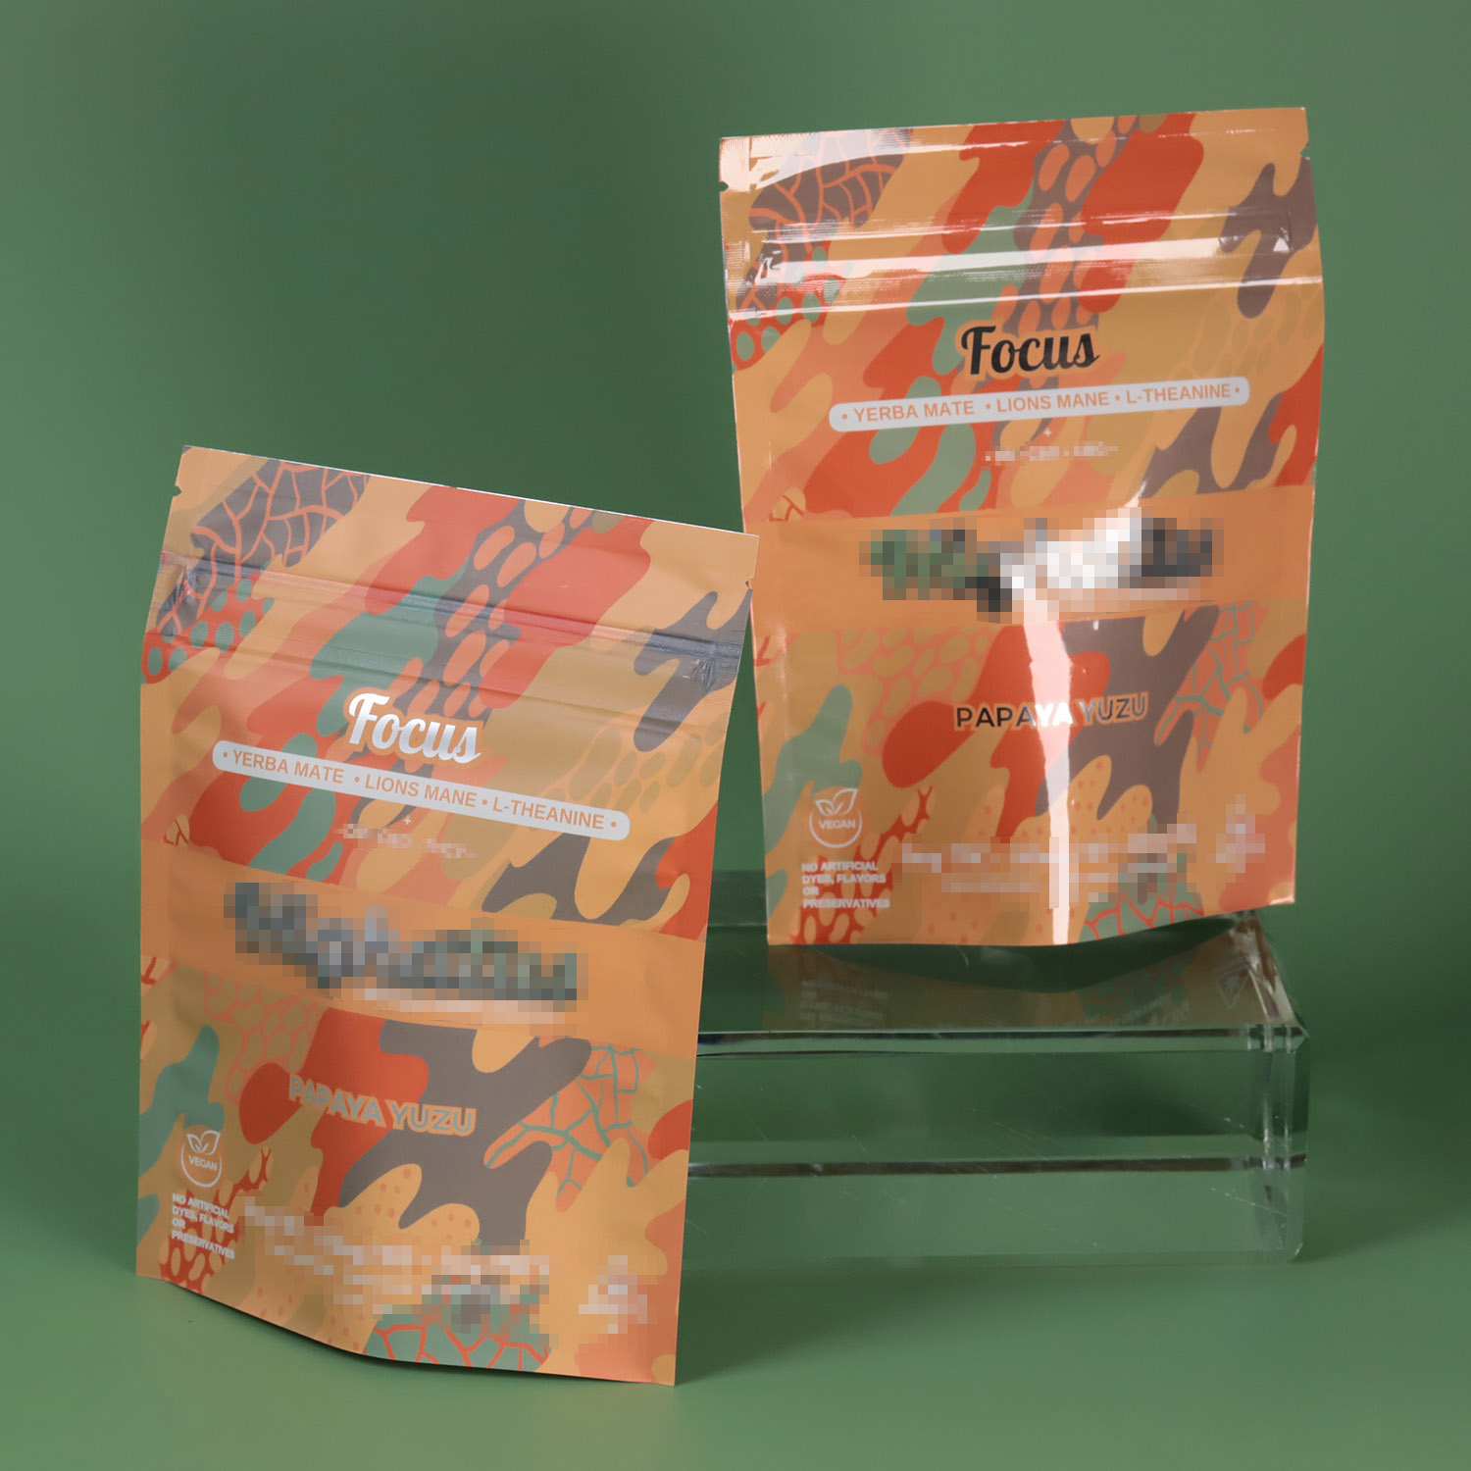
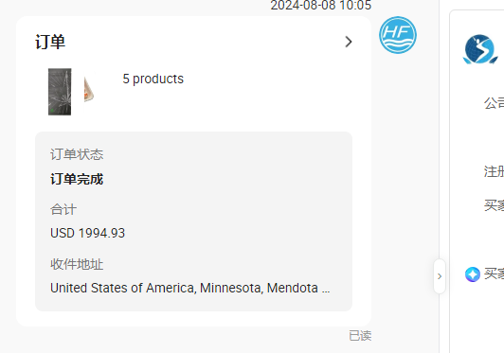
Sewwards is a environmentally friendly packaging solutions company located in MN USA, dedicated to 100% compostable products and safe products
for children. Including packaging cans and bags. As a packaging distributor, they supply product and service to whole USA market. Is our ideal client.
https://www.sewardsolutionsgroup.com/
Company website slogan
In mid July 2024, we received inquiry from him who expressed interest in purchasing compostable child safety packaging bags from China and hoped
to receive assistance from the supplier. The main issues are product structure, child safety, and design implementation.
After several online communications, we have confirmed with him the use of children's zipper locks and biodegradable high barrier 401 structure products
for packaging HEMP products. During this period, due to issues with printing fonts and intaglio printing costs, the construction plan was modified
several times, and the design draft was finally finalized. Digital printing was adopted to reduce the problem of excessive initial investment
In early August 2024, the customer
placed the first batch of orders for
1000 units of each of the five designs.
As a quality inspection and supply
cycle test, we successfully met the
customer's needs.
Design communication

Slide 2
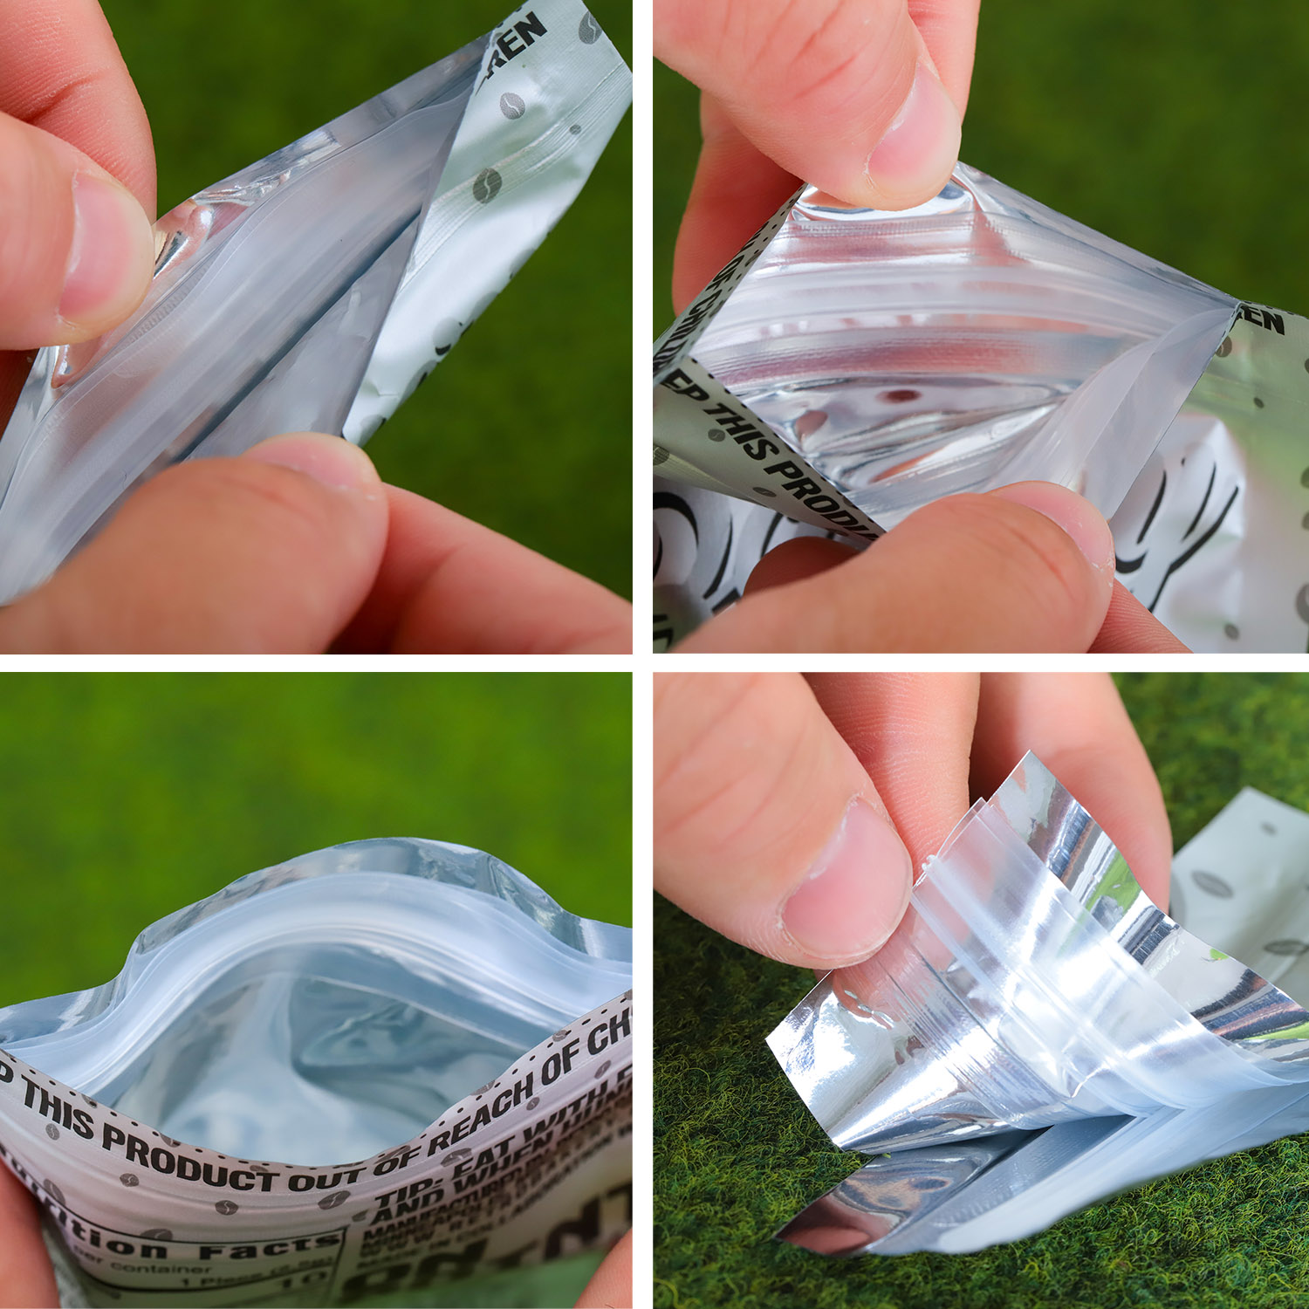
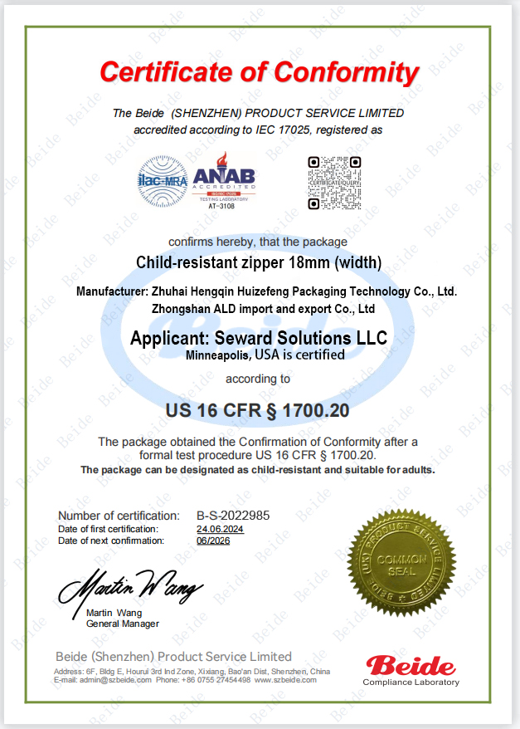
HEMP products, which are highly valued for children's safety in the US market, are an essential mandatory standard. In order to meet the
requirements of the customer's market development, we have completed the safety certification of the children's zipper in the shortest
possible time, which has become a key element in gaining customer recognition.
CR
Zipper bag
CR zipper
certificate

Slide 3
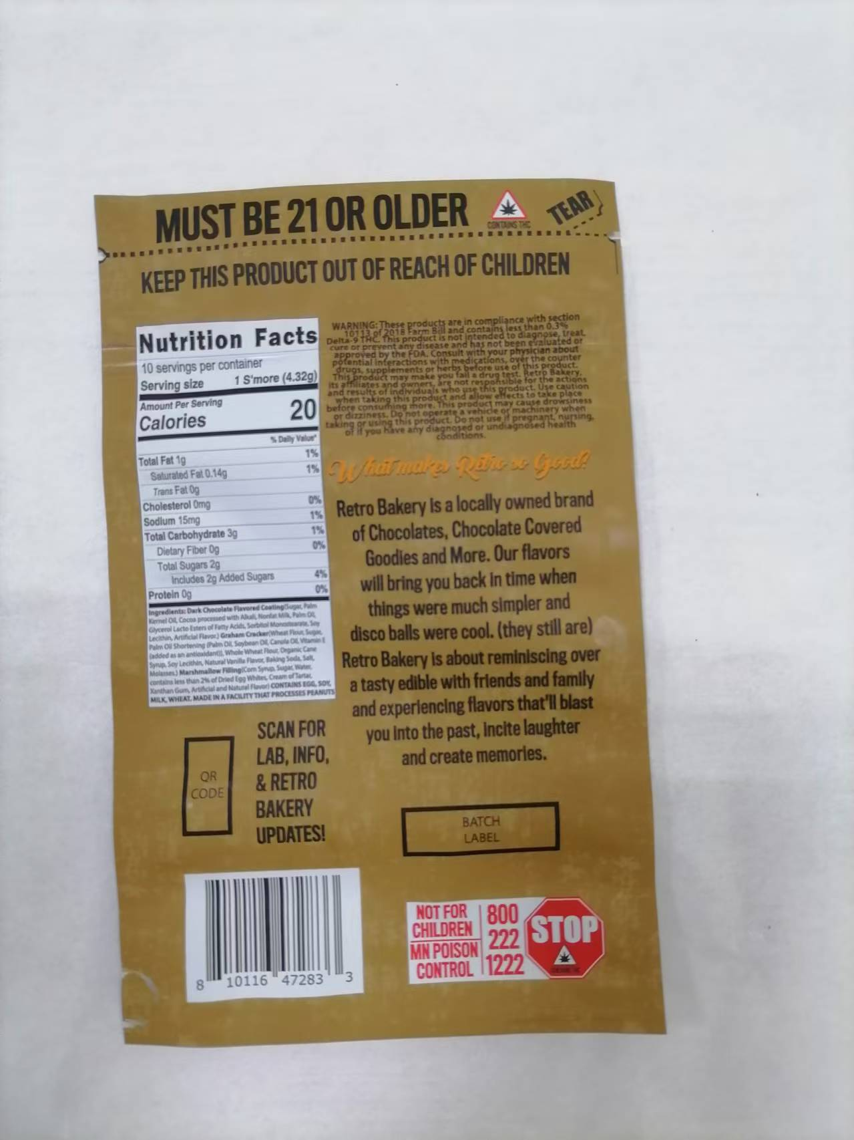
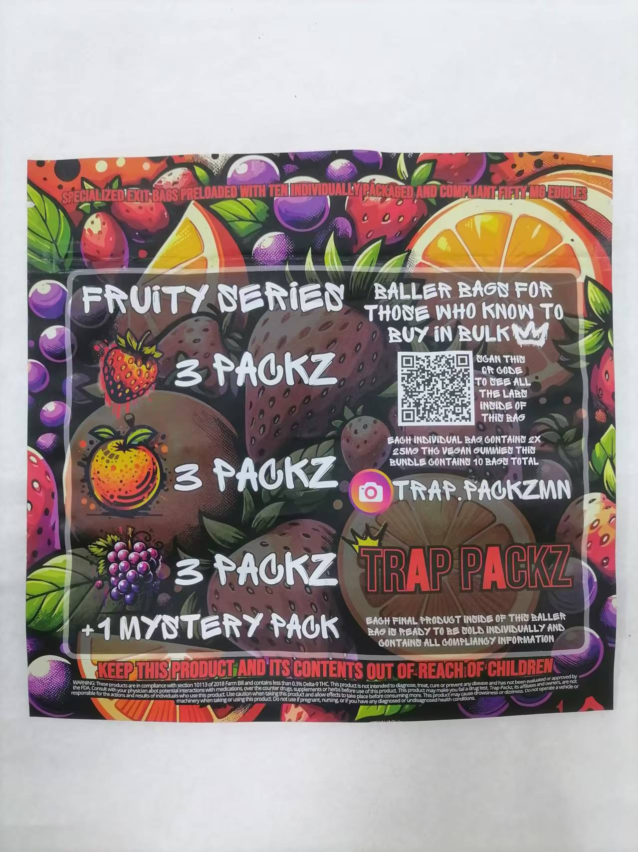
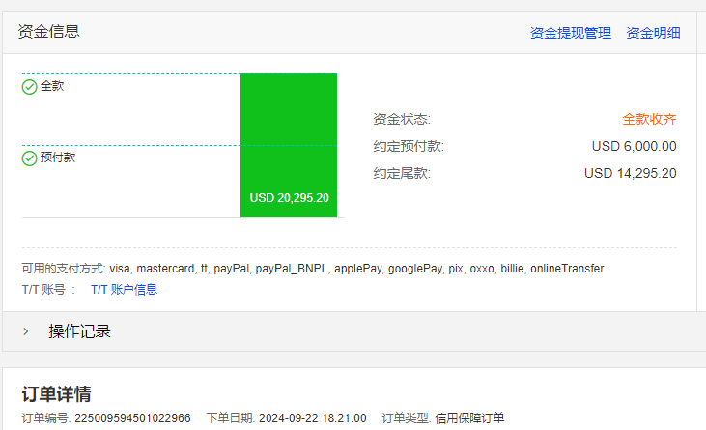
The customer received the first batch of products in August, which fully met the packaging requirements of HEMP products after testing,
and the printing was dedicated and the production was fine. the customer placed another end customer order in September,
HEMP packaging 23 designs in total 230000 pieces.
The difficulty of this packaging production is that the customer needs velvet tactile bags, and the customer's design colors are very diverse.
Using traditional gravure printing will result in a very high cost for the printing plate. After consultation with the customer, it was decided
to adopt a digital printed velvet touch film that had not been done before to reduce cost investment, but printing overlay needs to be tested
to help the customer solve the problem. After communication and coordination with technical personnel, the order was completed
on time and with quality.

Slide 4
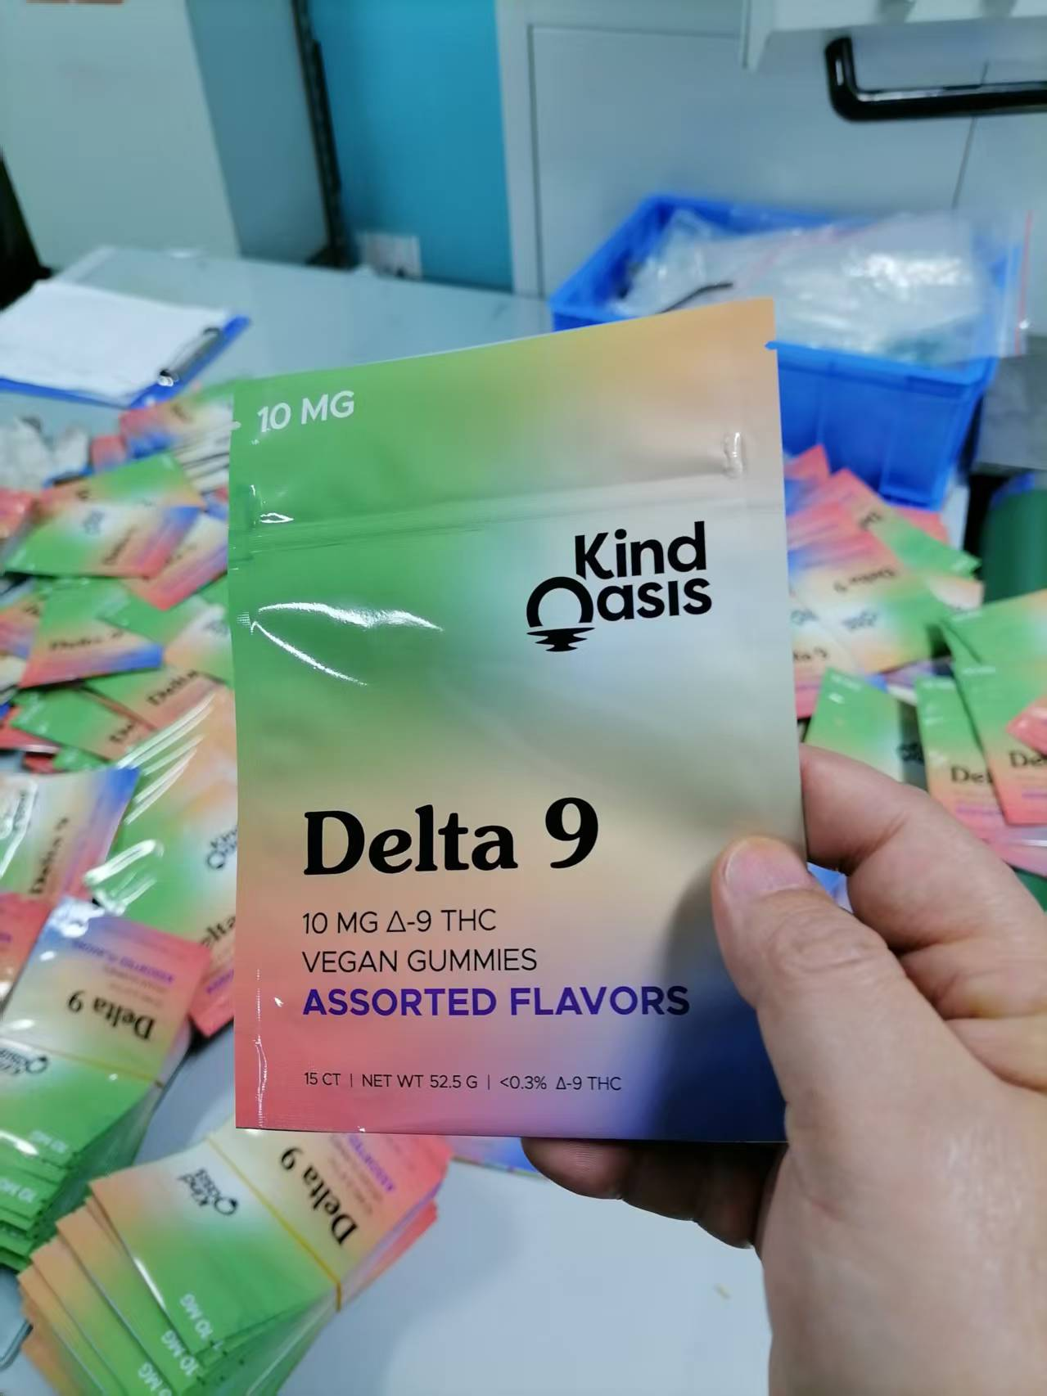
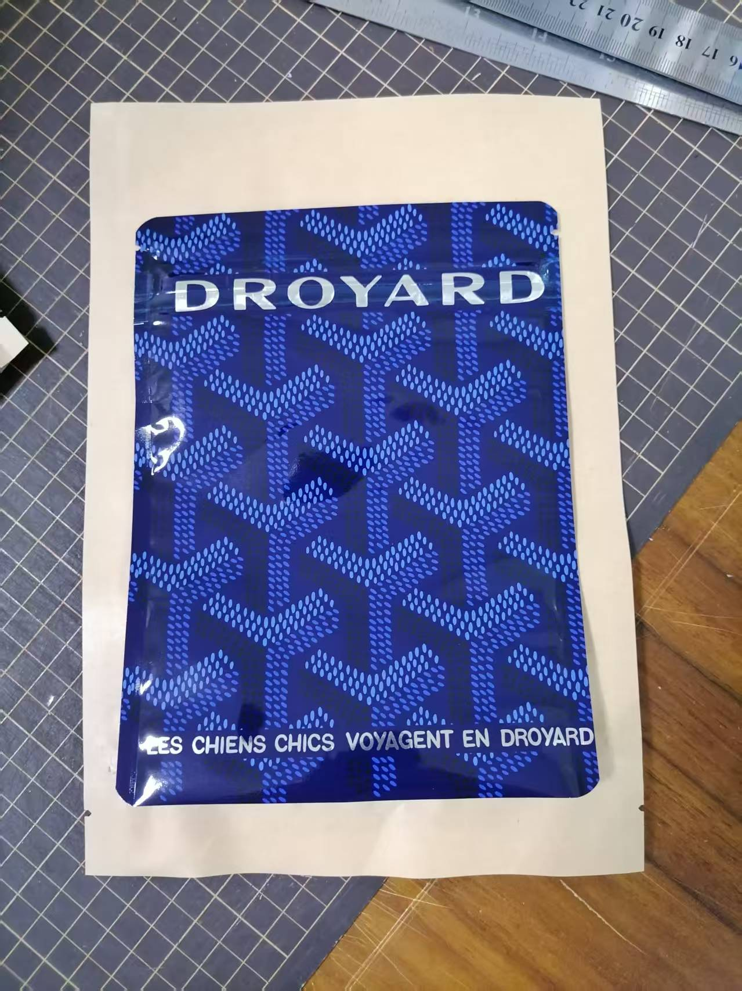
After the first two collaborations, the customer is very satisfied with our services and product, also helped him develop a biodegradable HEMP
product packaging line in the United States. He is currently constantly developing new brand end-users and promoting our multi-layer structure
biodegradable flexible packaging as his flagship product.
The bags made by the customer have three edge seals, self-supporting bags, and eight edge seals. The printing methods include digital printing
and gravure printing, and the materials used include biodegradable materials such as PLA, cellophane, PBS, etc. There are two-layer, three-layer,
and even four-layer structures. The customer is not very familiar with the impact of the bag's structure on its application. During the communication
and production process, we provided professional explanations and suggestions based on their actual usage scenarios,
which were recognized by the customer.

