Slide 1
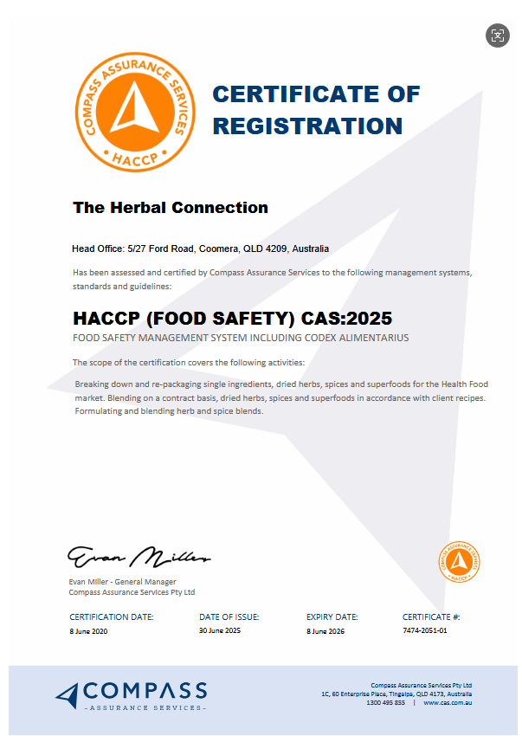
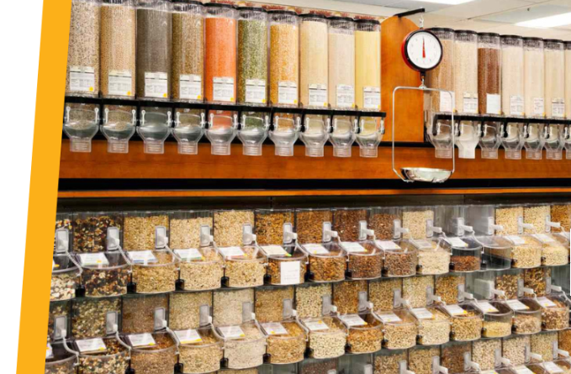
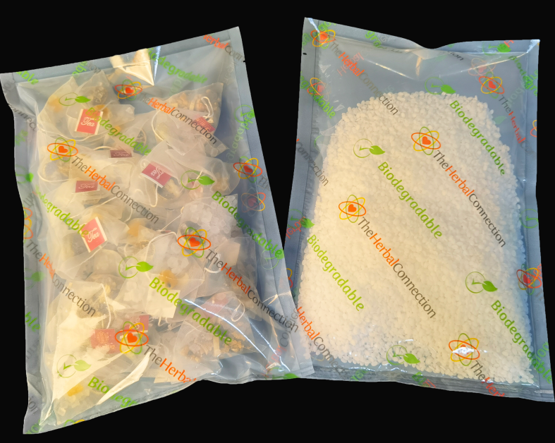

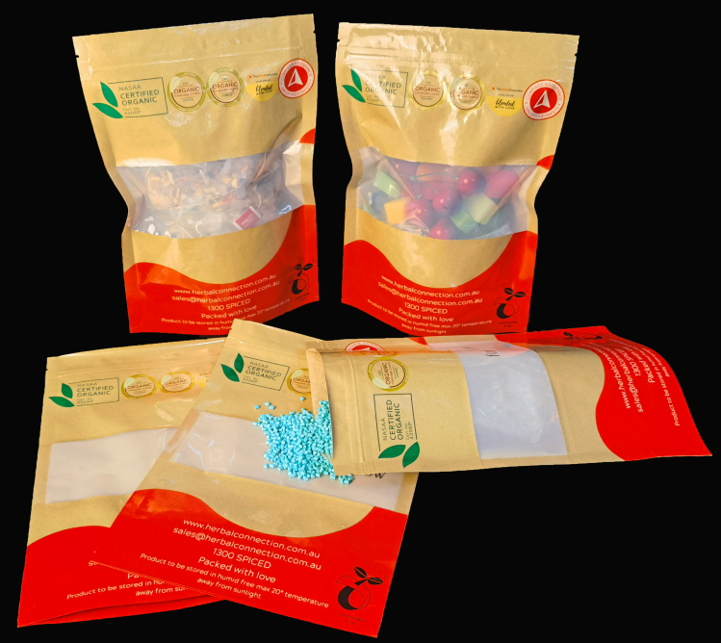

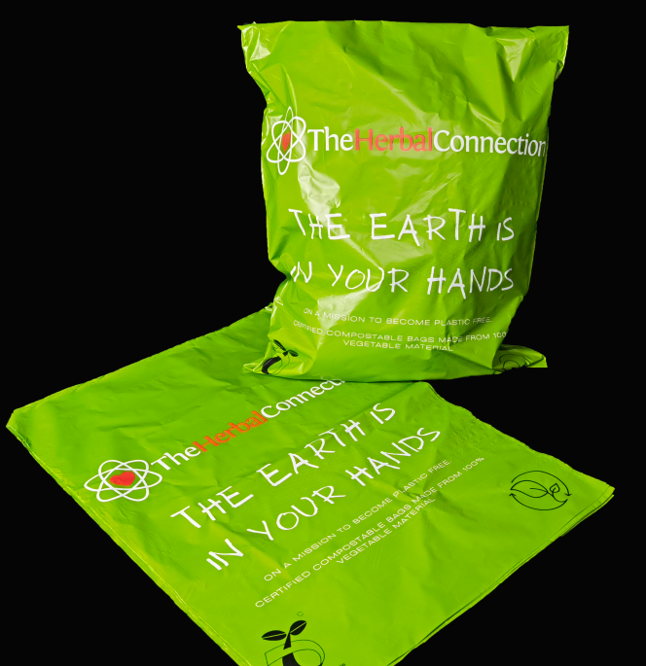

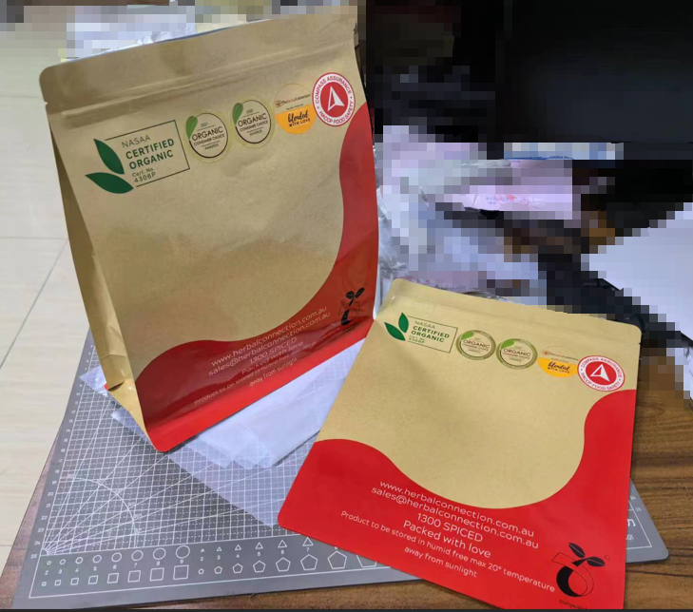
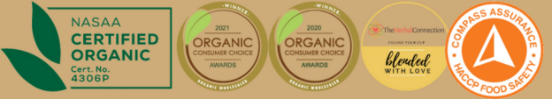
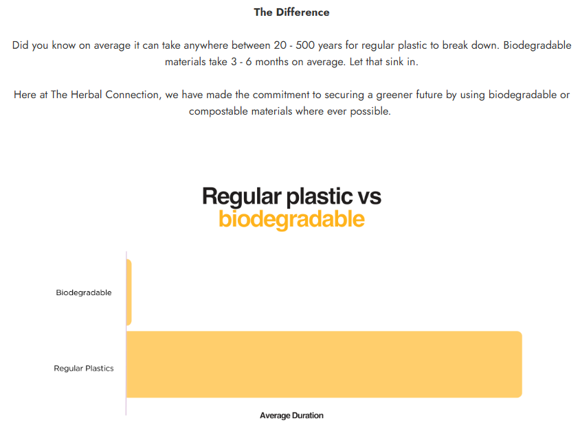
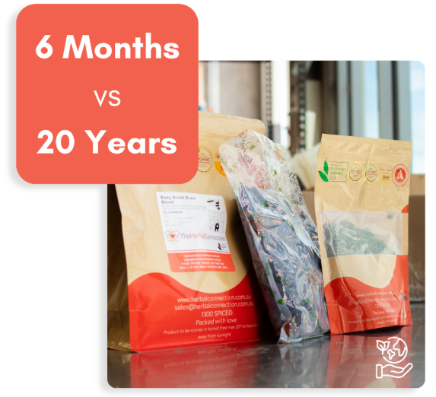
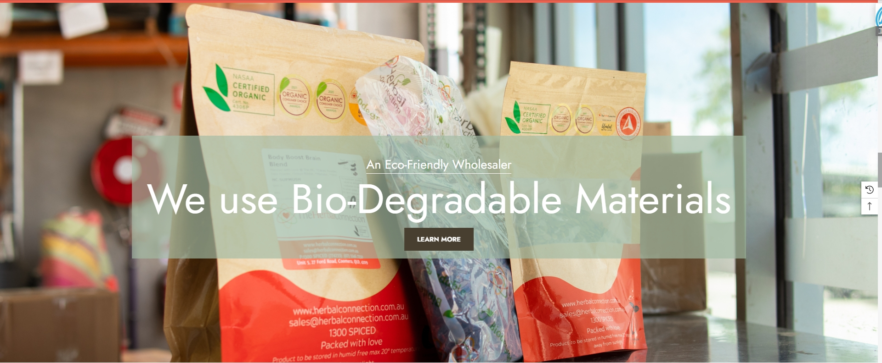
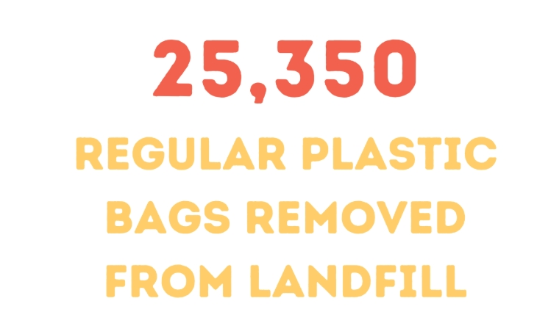
The Herbal Connection
https://herbalconnection.com.au/
Why Choose Our Biodegradable Packaging Solutions?
Expertise in Customized, High-Performance Biodegradable Packaging
The Herbal Connection offers a wide range of herbal products, each with unique packaging requirements — from varying barrier properties to different bag styles. These diverse needs present a significant challenge for biodegradable packaging. Our company possesses the in-house R&D and manufacturing capabilities to develop tailored biodegradable solutions for a wide range of applications, ensuring both functionality and sustainability.
Certified Quality and Safety
Our biodegradable packaging products hold multiple international certifications and patents. Every product undergoes rigorous testing by independent third-party laboratories and meets food-grade safety standards, including FDA and SGS certifications — ensuring safety, reliability, and regulatory compliance.
Truly 100% Biodegradable Packaging Solutions
After countless rounds of testing and analysis, we developed a comprehensive biodegradable packaging system. Each bag style is precisely engineered to protect its specific product, maintaining dryness and freshness while remaining fully biodegradable. Even the zippers and inks used are made from biodegradable materials — making the entire package 100% biodegradable, from every component to the final structure.
The Herbal Connection is an Australian producer of herbal plants and tea with a large factory and production line.
At The Herbal Connection, they proudly offer one of the most comprehensive wholesale selections of herbs in Australia. Their product range includes over 300 varieties, covering certified organic, wild, and traditional herbs.
Committed to producing healthy and all-natural products, they strongly believe in ecological protection and green practices. This led them to seek biodegradable packaging solutions that align with their values and product requirements. They reached out to us to develop a customized biodegradable packaging solution that covers their full product range — one that would perfectly match the needs of each individual product.
The client was extremely satisfied with our proposal. When they decided to go greener and invest in eco-friendly packaging, their goal was to ensure that at least 80% of their packaging was biodegradable.
We can confidently say that they have not only met but exceeded this target — significantly reducing the number of conventional plastic bags ending up in landfills.
In 2025, they are set to further advance their environmental efforts. We will continue working closely with them to develop new biodegradable packaging solutions, supporting their mission toward a more sustainable future

